Slide 1

City of London
Carling Creek Stormwater Management Master Plan – Municipal Class Environmental Assessment
Public Information Centre 1
Notes:
Hello, and welcome to the first Public Information Centre for the City of London’s Carling Creek Stormwater Management Master Plan.

Slide 2
Welcome
Monica McVicar, P.Eng.
Project Manager
City of London
Stormwater Engineering
Nicholas Krygsman, P.Eng.
Project Manager
Matrix Solutions Inc.
Matthew LeGrand
Hydrology Lead
Matrix Solutions Inc.
Phil Campbell
Municipal Infrastructure
Matrix Solutions Inc.
Notes:
I will introduce the project team before we get started. Monica McVicar is overseeing the Master Plan as the project manager on behalf of the City of London and Nicholas Krygsman is a senior water resources engineer with Matrix Solutions in the role of consultant project manager. The key team members also include Matthew LeGrand, leading the hydrology portion of this study, and Phil Campbell, responsible for providing input into the development of alternative solutions requiring the design of municipal infrastructure.

Slide 3
Land Acknowledgement
We want to acknowledge that we are on lands traditionally occupied by Indigenous Peoples. They continue to care for this land, they continue to shape the City of London, and we want to show our respect. Hundreds of years after the first treaties were signed, they are still relevant today.
Notes:
We want to acknowledge that we are on lands traditionally occupied by Indigenous Peoples. They continue to care for this land, they continue to shape the City of London, and we want to show our respect. Hundreds of years after the first treaties were signed, they are still relevant today.

Slide 4
Presentation Format
This meeting is being hosted as a pre-recorded video.
If you have downloaded the slides independently of the video, please be sure to read the attached script.
Notes:
In accordance with ongoing public health guidelines, the City of London is hosting public meetings over virtual platforms. This meeting is being hosted as a pre-recorded video to ensure it is available to review at your own convenience. The presentation is approximately 30 minutes long and is available for download at the link in the description as a pdf with the script attached to each slide. Please take the time to review the entire presentation and provide feedback.

Slide 5
Agenda
Introduction
  Project Overview and Purpose
  Environmental Assessment Process
  Study Area Review
Hydrology and Hydraulic Modeling Update and Flood Risk Assessment
Potential Stormwater Management Solutions for Carking Creek
Development of Stormwater Management Alternatives and Evaluation Criteria
Next Steps in the Environmental Assessment Process
Notes:
The agenda for this presentation includes an introduction including project overview and purpose, a review of the provincially recognized Environmental Assessment process, a description of the study area, and a summary of the work completed to date. Following the introduction, I will present a review of the hydrology update portion of the study. Then I will provide a brief overview of some of the stormwater management solutions that are being considered for the Carling Creek watershed. Following that, I will present project-specific objectives and evaluation criteria that will be used to determine the preferred servicing alternative(s) that will fulfil the problem statement. Lastly, I will outline the next steps in the Municipal Class Environmental Assessment Master Plan process.

Slide 6
Project Overview and Purpose
Assess and characterize existing and potential future flood risk within the Carling Creek watershed (Core Area) taking into consideration the impacts of future climate change
Update previously developed system‑wide storm sewer model with new and proposed municipal infrastructure
Identify and confirm specific areas of historic and potential surface flooding risk and use this information to determine the level of service of existing infrastructure
Develop a flood mitigation implementation and prioritization plan for improvements to the City’s storm drainage infrastructure
Notes:
The downtown core of the City of London continues to evolve and redevelop. Currently, the core area is serviced with a complex system of stormwater infrastructure, some of which has been in existence for more than 100 years. The City initiated the Stormwater Management Master Plan study to plan and prepare for future redevelopment and infrastructure improvement within the downtown area that will address existing and future flooding risk. Through this project, we will assess and characterize existing and potential future flood risk within the Carling Creek watershed. To do this, we have developed system‑wide storm sewer models that will be used as the primary flood risk management tools both for this project and for the City’s use going forward. These detailed models enable us to evaluate the improvement alternatives’ effectiveness in addressing level of service deficiencies and, comparatively, evaluate those alternatives from a flooding reduction and cost perspective.
Following this flood risk characterization, we will work with the City to develop a long-term flood mitigation implementation and prioritization plan for improvements to the City’s drainage infrastructure. The Master Plan will ultimately fulfil the requirements of the Environmental Assessment process and allow the City to integrate improvements into other initiatives such as the ongoing Infrastructure Renewal Plan and Bus Rapid Transit program.

Slide 7

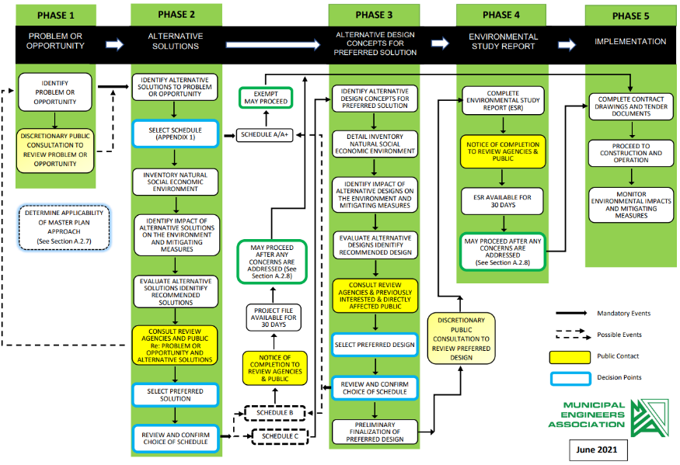
Municipal Class EA Process
Master Plan process includes Phases 1 and 2 only
We are here
Notes:
The Stormwater Master Plan is being completed following the provincially recognized Municipal Class Environmental Assessment process. This process includes up to five phases depending on the type and complexity of the study. A Master Plan consists of Phases 1 and 2 only. Phase 1 is called Problem and Opportunity. This includes the assessment of existing conditions to identify the “problem” to be remedied and the “opportunities” available within the confines of the project. With this Public Information Centre, we are nearing the completion of Phase 1 of this process.
Phase 2 is called Alternative Solutions. In this upcoming phase, we will develop and evaluate alternative solutions to address flood risks identified within the City. Following Phase 2, we will have a second Public Information Centre, which will be conducted similarly to this one. Updates will be posted in the local newspaper and on the City's project webpage.

Slide 8
Problem and Opportunity Statement
The City of London is undertaking a Stormwater Management Master Plan for the Carling Creek Watershed. The Master Plan will develop a long‑term stormwater management strategy that addresses stormwater servicing deficiencies, surface flooding, and infrastructure renewal for existing and future land use within the area described as the “Core” of the City of London.
Notes:
The Problem and Opportunity Statement for this project is as follows:
The City of London is undertaking a Stormwater Management Master Plan for the Carling Creek Watershed. The Master Plan will develop a long-term stormwater management strategy that addresses stormwater servicing deficiencies, surface flooding, and infrastructure renewal for existing and future land use within the area described as the “core” of the City of London.
This statement was developed based on findings throughout Phase 1 of the Master Plan process.

Slide 9
Carling Creek Watershed Background Information Summary
Notes:
Next I will provide an overview of the Carling Creek watershed.

Slide 10
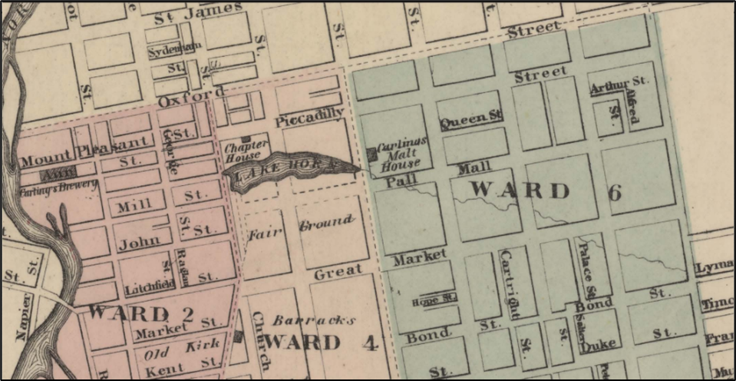
Study Area Review
  Carling Creek is a historic watercourse that flows west through the downtown ‘Core’ of the City of London. Dating back nearly 150 years, Carling Creek has evolved from a natural creek to an urban waterway, to an almost completely enclosed stormwater drainage system.
  The evolution of the watercourse, which at one point involved the construction of a dam across Richmond Street and the creation of a water body historically referred to as Lake Horn, has resulted in obstructed overland flow paths and flooding problems throughout the watershed.
Historic map of Lake Horn, London
Notes:
Carling Creek is a historic watercourse that flows west through the downtown “core” of the City of London. Dating back nearly 150 years, Carling Creek has evolved from a natural creek to an urban waterway, to an almost completely enclosed stormwater drainage system.
The evolution of the watercourse, which at one point involved the construction of a dam across Richmond Street and the creation of a waterbody historically referred to as Lake Horn, has resulted in obstructed overland flow paths and flooding problems throughout the watershed.

Slide 11
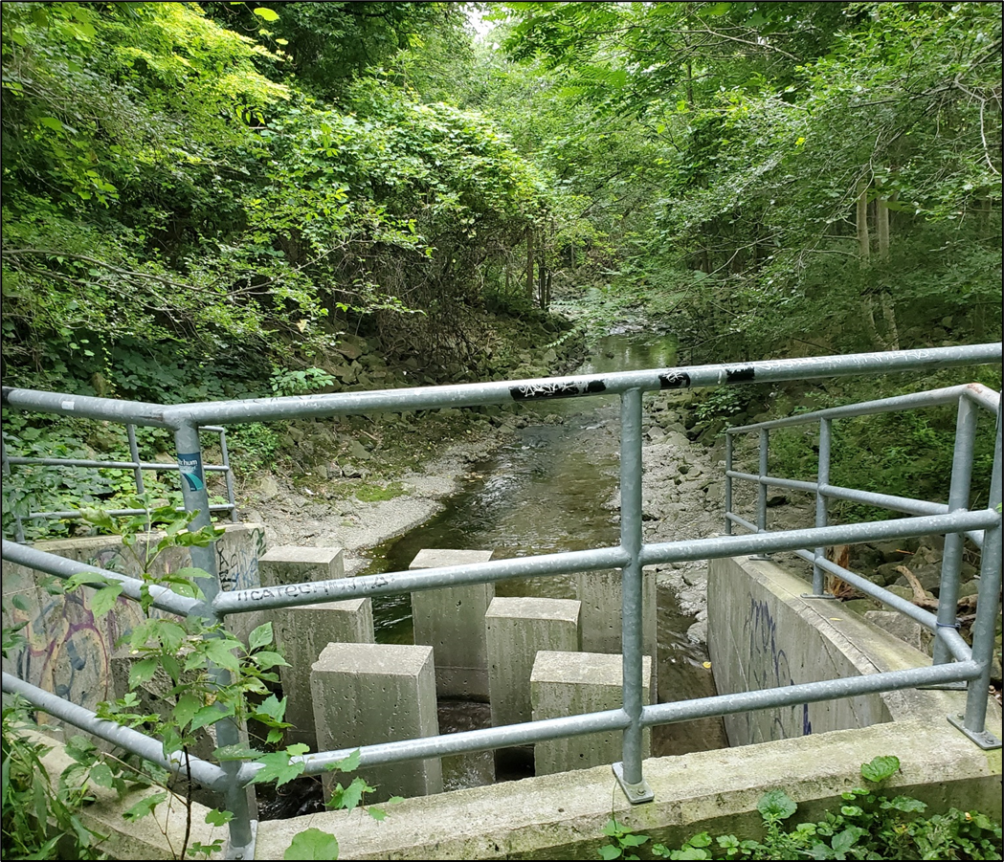
Study Area Review
  The Carling Creek watershed is divided into two sections: a northern branch, commonly referred to as Trunk A, and a southern branch, which is comprised of two main trunk sewers referred to as Trunk B and Trunk C.
  All three branches of the Carling Creek drainage system have a history of surface water flooding within municipal road right-of-way and private properties.
Carling Creek Sewer Outfall, west of Talbot Street
Notes:
The Carling Creek watershed is divided into two sections: a northern branch commonly referred to as Trunk A and a southern branch, which is comprised of two main trunk sewers, referred to as Trunk B and Trunk C.
All three branches of the Carling Creek drainage system have a history of surface water flooding within the municipal road right-of-way and private properties.

Slide 12
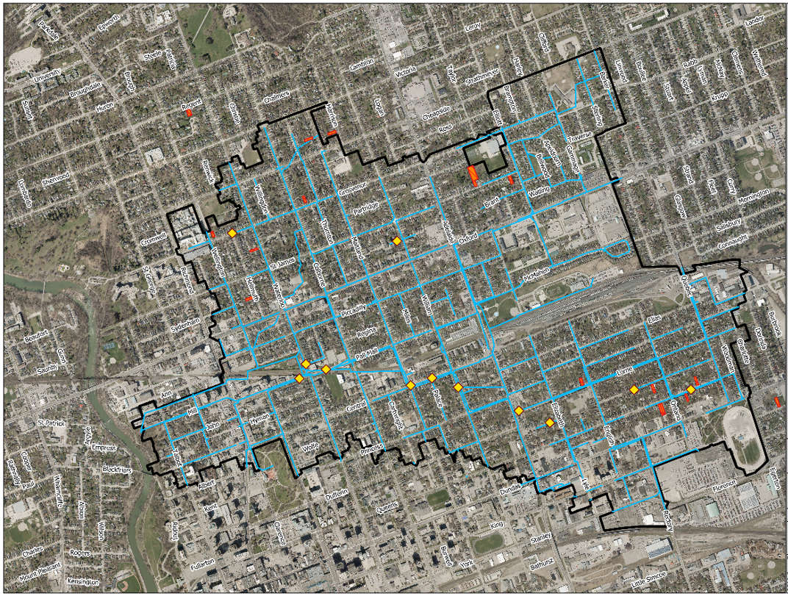
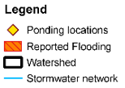
Historical Flooding Reports
Notes:
The study area for this project includes a significant portion of the downtown core of the City of London. The study area is indicated by the black polygon on the map. Some of the modelling and flooding analyses extend beyond the Carling Creek watershed boundary. This ensures we can adequately assess features and conditions near the edge of the study area. As shown on the figure, there is reported flooding throughout the study area and chronic ponding locations along major transportation corridors throughout the downtown area. The Carling Creek Stormwater Management Master Plan aims to address flooding risk and provide a long-term plan that will facilitate redevelopment and infrastructure improvement/renewal in the downtown core.
The study area falls with the jurisdiction of the Upper Thames River Conservation Authority.

Slide 13
Hydrologic/Hydraulic Model Update and Flooding Risk Assessment
Notes:
Next I will provide an overview of the hydrology update for the Carling Creek watershed.

Slide 14
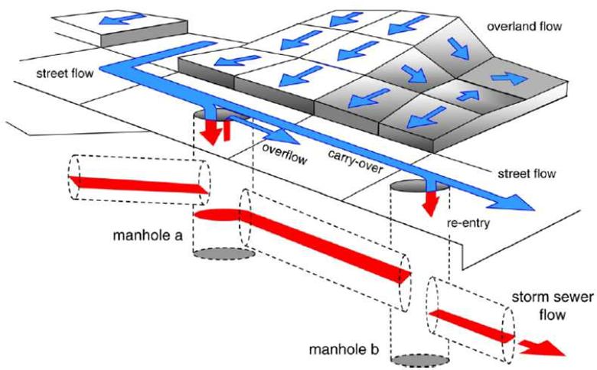
Urban Drainage Assessment Methods
Purpose of urban modelling
This model includes:
  Overland flows
  Ditches
  Inlets (catch basins)
  Sewers and manholes
Notes:
The completed urban drainage assessment is based on an integrated model considering overland topography and flow, ditches, culverts, sewer inlets (such as catch basins and ditch inlets), and the sewer pipes. These components work in an interconnected way, both in real life and in the model. Runoff from rainfall events enters the storm sewer (known as the minor system) through catch basins and ditch inlets. Flow beyond the capacity of the inlet (the catch basin opening) will pond or travel on the surface and along roads. When the sewer is full, surcharge occurs and the water travels out of the full sewer onto the road. The flow in the sewer will continue downstream to outlet in a river or stormwater management pond. Flow on the surface will travel in downhill directions based on the topography. It will be recaptured into the sewer system if it passes a catch basin with available capacity, or it will continue to flow overland to a ditch or creek.
The City has developed models of the storm and combined sewers within the area commonly referred to as the downtown Core. This includes a majority of the Carling Creek watershed. The project team has expanded this model to assess the existing conditions of the sewers and identify areas of higher flood risk within the Carling Creek watershed. In future tasks of this project, we will use this model to evaluate mitigation options to reduce the flood risk in identified areas. The model was previously validated using the rainfall and available flow monitoring data to confirm the results are appropriate. The stormwater collection systems are most impacted by short-duration, high-intensity rainfalls, like summer thunderstorms.

Slide 15
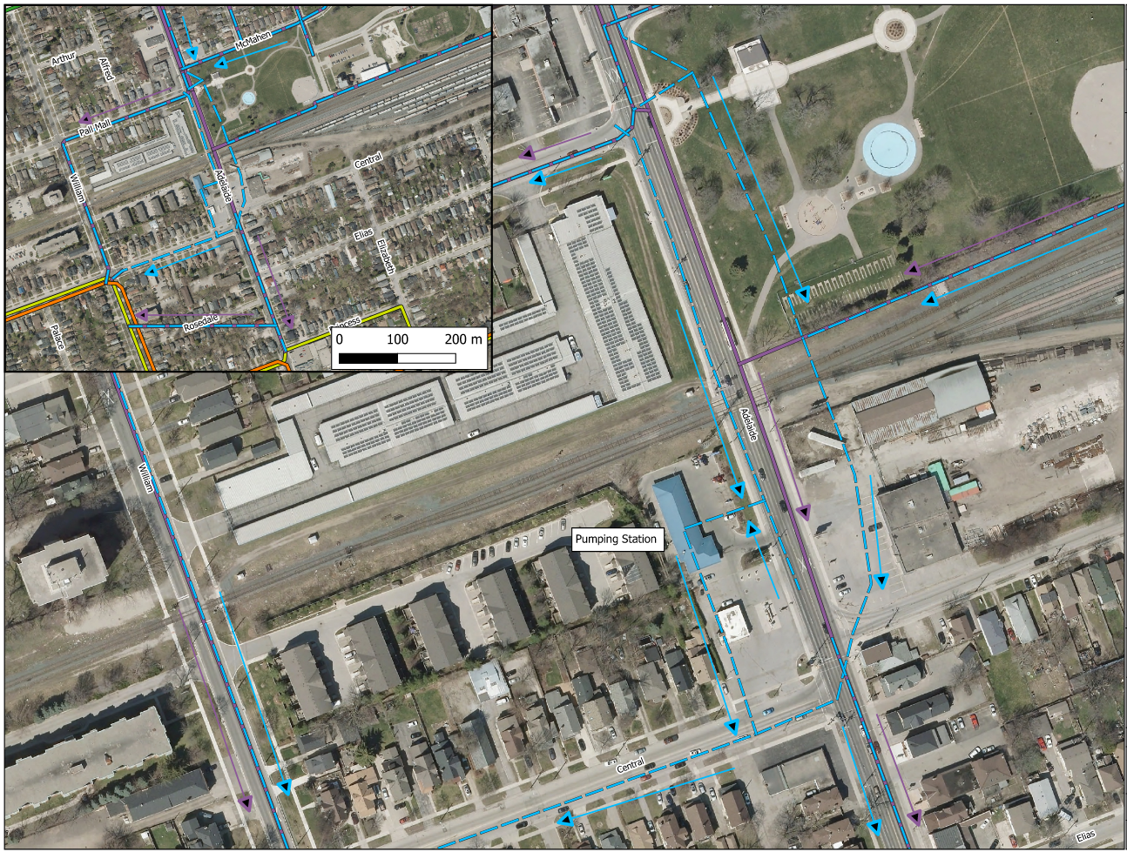
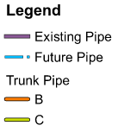
InfoWorks Model Update
Adelaide Street Grade Separation Project
Proposed infrastructure improvements associated with the Adelaide Street Grade Separation projects have been incorporated into the InfoWorks hydrologic/hydraulic model.
Modeling details include the integration of storm sewers along Central Ave, Adelaide Street and the integration of a stormwater management system.
Notes:
Since the initial Carling Creek (core area) InfoWorks model was developed, there have been a number of construction projects either completed, initiated, or planned to be complete in the immediate future. In order to represent the hydrologic characteristics of Carling Creek, a detailed update of the InfoWorks model was undertaken. The model updates include the following key infrastructure renewal and improvement projects:
the Adelaide Street Grade Separation Project (shown in the graphic)
roadway and sewer improvements throughout Old East Village
proposed storm servicing improvements along William Street in Old North
proposed Bus Rapid Transit-related improvements along the York Street corridor (particularly at Rectory Street)

Slide 16
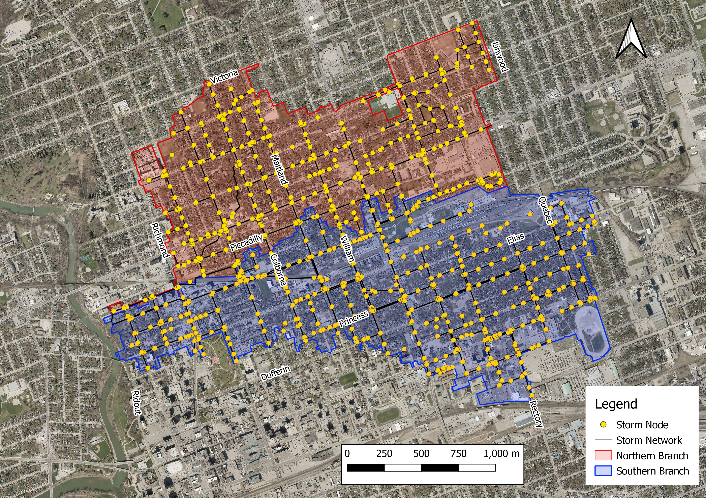
Hydrologic Modeling
Carling Creek Northern Branch:
Drainage area = 2.25 km²
Flows east-to-west through Old North crossing Oxford Street and connects with the main branch of Carling Creek
Services mixed land use along Oxford with primarily residential properties to the north.
Infrastructure ranges in age from 4 to 120 years old.
Carling Creek Southern Branch:
Drainage area = 2.76 km²
Flows east-to-west through a portion of Old East Village, snaking along sections of Lorne Ave, William Street, Central Ave, Pall Mall and Mill Street.
Discharges to the North Thames River within Harris Park (south of Oxford Street).
Mixed land use including commercial, institutional and residential.
Infrastructure ranges in age from 5 to 120 years old.
Notes:
Carling Creek Northern Branch encompasses a drainage area of approximately 2.25 km². The northern branch of the storm sewer flows east-to-west through Old North, crossing Oxford Street, and connects with the main branch of Carling Creek. The storm sewer system services mixed land use along Oxford, with primarily residential properties located to the north of the Oxford Street corridor. Infrastructure ranges in age from 4 to 120 years old.
Carling Creek Southern Branch encompasses a drainage area of approximately 2.76 km². The southern branch of Carling Creek flows east-to-west through a portion of Old East Village, snaking along sections of Lorne Avenue, William Street, Central Avenue, Pall Mall, and Mill Street. The main branch of the Carling Creek storm sewer system discharges to the North Thames River within Harris Park (south of Oxford Street). The storm sewer system services mixed land use including commercial, institutional, and residential properties. Infrastructure ranges in age from 5 to 120 years old.

Slide 17
Summary of Work Undertaken to Date
Background Review and Model Review undertaken during 2021 and 2022
Focussed on updating InfoWorks hydrologic/hydraulic model and understanding existing conditions/level of service of storm drainage infrastructure
Modeling used to confirm locations of historical flooding and identify areas of potential flooding risk under a range of design storm events.
Model updated to reflect recently constructed municipal infrastructure in Old North and Old East Village, and proposed infrastructure along Adelaide Street and York Street.
Modeling results generally match areas of historic flooding and identify the main Branches of the Carling Creek storm sewer as having deficient capacity to convey the City of London ‘Standard’ 1:2-year storm event which is equivalent to a 1:5-year storm as defined by Environment Canada.
Notes:
The Carling Creek Stormwater Master Plan study has progressed through the background review and model review phases in 2021 and 2022. The work to date has focused on updating the InfoWorks hydrologic/hydraulic model and understanding existing conditions/level of service of storm drainage infrastructure. To date, the model has been used to confirm locations of historical flooding and identify areas of potential flooding risk under a range of design storm events. A significant amount of time has been spent updating the model to reflect recently constructed municipal infrastructure in Old North and Old East Village and proposed infrastructure along Adelaide Street and York Street. The assessment of the performance of infrastructure impacted by these projects has also been completed as part of this project. Modelling results generally match areas of historic flooding and identify the main branches of the Carling Creek storm sewer as having deficient capacity to convey the City of London “standard” 1:2-year storm event.

Slide 18
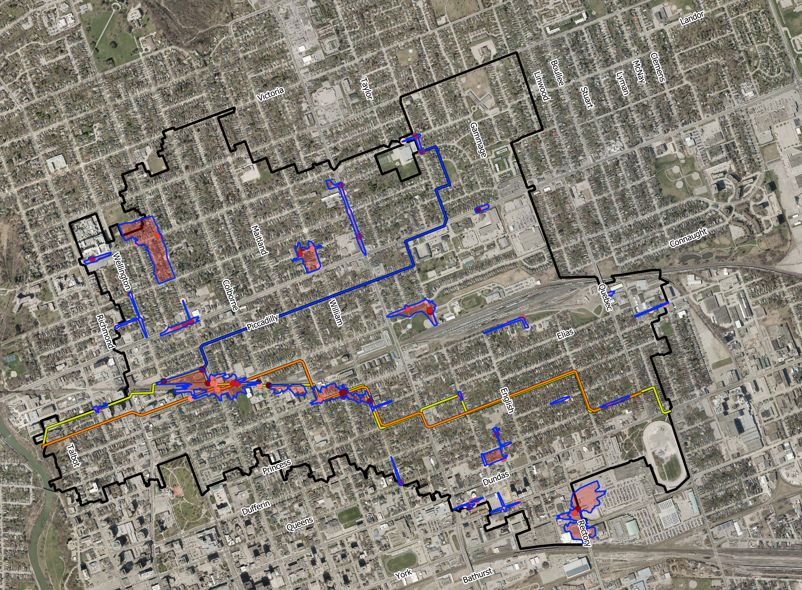
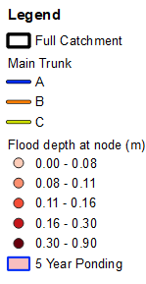
Flooding Risk Assessment
Estimated peak flows for the 1:5-, 1:10-, 1:25-, 1:50-, 1:100-Year Environment Canada Storms.
Applied hydraulic grade line results to local topography and roadway geometry to determine extents of surface flooding.
Identified at-risk properties, correlating results to historically reporting flooding incidents.
Notes:
Peak flows were estimated for a range of flood events. Flood events are described by the annual probability of occurring. For example, a 100-year flood event means a flood of a magnitude that has a 1 in 100, or 1%, chance of happening every year. A 5-year flood event, means a flood of a magnitude that has a 1 in 5, or 20%, chance of happening every year.
The calibrated model was used to run the design storm events under existing and planned land use conditions. We simulated the 1:5- through 1:100-year storm events. The graphic illustrates the areas identified as having a flood risk under the 1:5-year storm event. These areas correlate to historically noted private property and municipal right-of-way flooding. The updated Carling Creek model will be used to assess potential improvement alternatives and evaluate those alternatives’ effectiveness in reducing flooding impacts within the downtown core.

Slide 19
Potential Stormwater Management Solutions for Carling Creek
Notes:
Before we review stormwater management servicing alternatives, I will provide a short overview of some of the general stormwater management solutions that are typically used to address servicing improvements in urban settings.

Slide 20
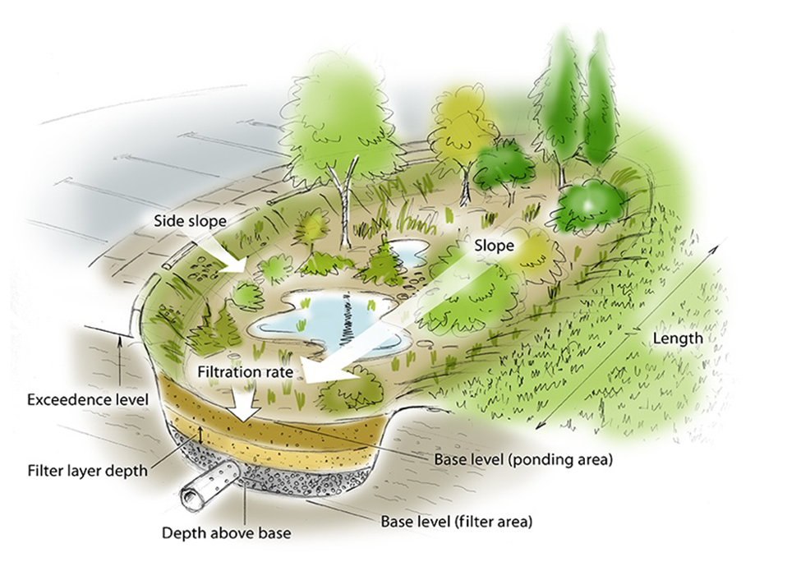
Bio-Retention Swales
A Low Impact Development (LID) solution that is often integrated into linear corridors.
Applied to areas with pervious surficial soils and can be designed as storage systems or to provide additional capacity for climate change resilience.
Notes:
Bioretention Cells are topographic depressions used to store and infiltrate stormwater. Cells contain natural vegetation to enhance attenuation and infiltration of stormwater and provide both quality and quantity control. There are typically multiple ground layers with the lowest layer designed as a gravel lining. Smaller cells without a gravel lining are sometimes referred to as rain gardens. Underdrains are sometimes included to allow for the redirection of groundwater.
Bioretention cells are useful for stormwater attenuation, as they enhance ecological diversity, require low maintenance, improve water quality, are highly customizable, and are aesthetically pleasing for the community. Bioretention cells can be used to fill small greenspace gaps between impervious areas and are highly malleable to the environment. They typically occupy less space than a stormwater pond and thus are ideal for smaller-scale catchments. The infiltration capabilities of a bioretention cell are dependent on the groundwater environment as well as the local soil type, and should be considered when designing a bioretention cell.

Slide 21
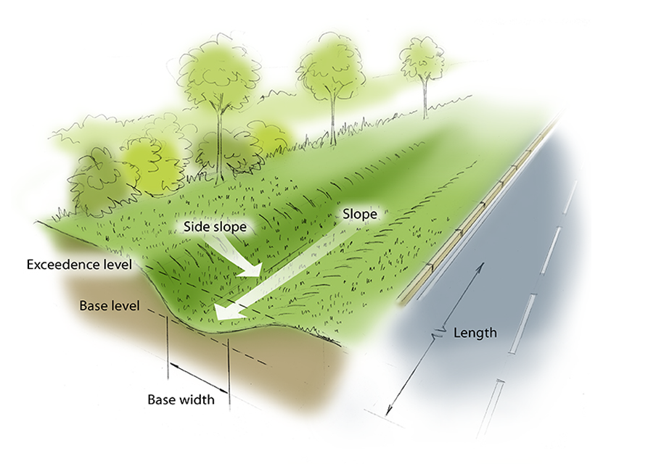
Hybrid Urban Roadway Cross-Sections
Linear trenches or roadside swales integrated into urban roadway right-of-ways.
Enhance stormwater attenuation and create conditions for infiltration, evapo-transpiration and vegetative uptake.
Can be used to enhance major overland flow conveyance where the storm sewer system lacks capacity.
Notes:
Bioswales are linear trenches that have natural vegetation to attenuate and infiltrate stormwater. Bioswales are similar to typical roadside ditches but have enhanced measures for increased stormwater attenuation and infiltration. Bioswales could be designed similarly to bioretention areas, with a base gravel layer and subsurface drain to operate as a dual system.
Bioswales are useful for stormwater control, as they can enhance existing roadside drainage or be placed between highway lanes as islands. Bioswales are visually appealing green infrastructure that can be used for increased water quality and quantity control. Bioswales offer limited enhancement as storage spaces and are better applied to attenuate rather than store flow. Swales must be maintained, such as being mowed and cleaned, in order to ensure a long lifespan and consistent functionality.

Slide 22
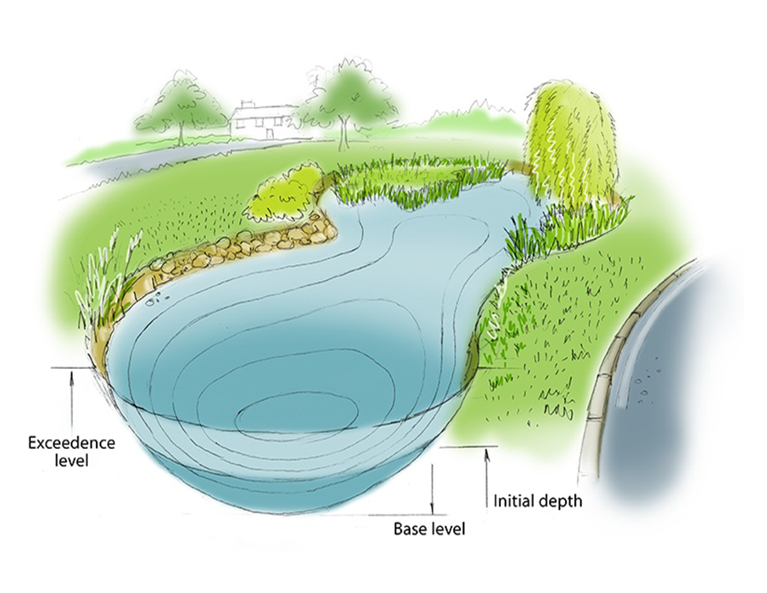
Stormwater Management Ponds
A traditional end-of-pipe stormwater management tool that is design to gather and store stormwater runoff.
Stormwater quality enhancement is achieved through settling of suspended solids prior to discharging to receiving water systems.
Can be strategically located within urban drainage areas to provide relief of existing storm sewer collection system.
Notes:
Stormwater ponds are a traditional stormwater management tool that are designed to gather rainfall and surface water runoff. The pond temporarily stores water and then releases it at a controlled rate, providing both water quality and quantity control. Stormwater ponds are common end-of-line facilities placed at the bottom of catchments to attenuate flow and control water quality.
Stormwater ponds are typically larger than bioretention cells and can be “wet” or “dry.” Wet ponds have permanently wet cells and are broken into forebays and main cells, with the former capturing most of the inbound sediment from runoff. Dry ponds have a lower footprint but do not control water quality to a great degree. While stormwater ponds occupy significant surface space, many are integrated into communities as natural features for wildlife habitats and improving park aesthetics. Ponds can provide significant stormwater attenuation.

Slide 23
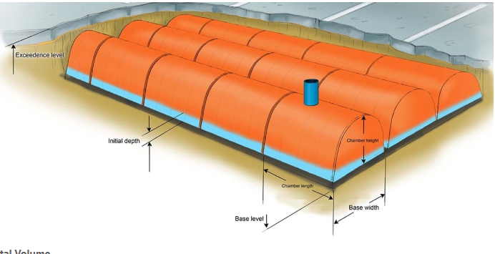
Underground Storage Chambers
Underground storage chambers are advantageous because they can be applied to a broad range of sites with varying land-use.
Storage is provided underground and therefore does not take up valuable space in an urban setting.
Because the chambers are required to be located underground, the size and complexity of these system is sometimes considered cost prohibitive.
The system can be enhanced where surficial soils provide some infiltration potential.
Notes:
Subsurface infiltration chambers are perforated cylinders with open bottoms which store and infiltrate stormwater. Chambers are installed below the ground surface along a storm sewer network (either online or offline) and capture and release stormwater at a controlled rate. Similar to stormwater ponds, infiltration chambers provide great attenuation potential due to the large capacity. The open bottom to the chambers allows for increased infiltration and groundwater recharge, and the controlled outlet pipe size allows for flows to be throttled. Subsurface chambers are useful at conserving impervious areas, such as parking lots, while providing a high degree of stormwater attenuation.
The infiltration and storage capabilities of subsurface storage depends largely on soil type and groundwater conditions. Subsurface tanks can be partially full at the start of storm events if they did not adequately drain from previous events or will have limited infiltration if the soil is fine or if the groundwater table is high.

Slide 24
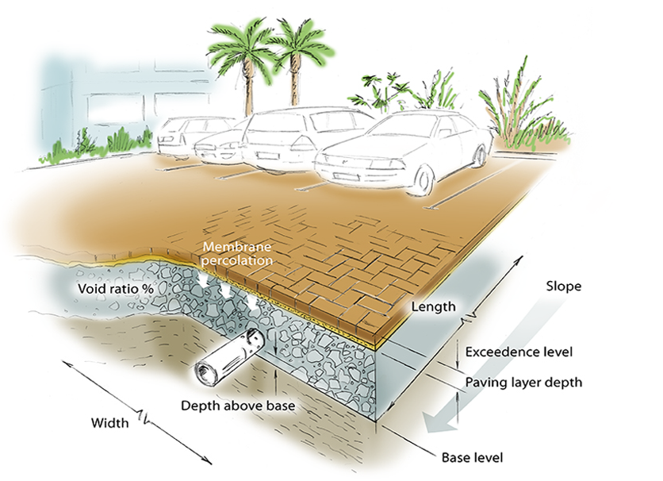
Permeable Pavement Systems
Permeable pavement systems are typically implemented in areas having favourable ground conditions and can replace standard parking lots, driveways and roads.
Typically used to reduce the level of imperviousness of a drainage area and therefore incrementally reduce the volume of stormwater runoff delivered to storm sewer collection systems.
Notes:
Permeable pavement is a porous surface that can be used to replace a standard concrete/asphalt for parking lots, driveways, or roads. Permeable pavement can be interlocking concrete blocks, a coarse grain asphalt/concrete, or a plastic grid system. Permeable pavement can also be grassed, which increases the visual appeal of a roadway or parking lot.
Permeable pavement is useful for converting impervious space to pervious space while maintaining the commercial and structural utility of the pavement. Developed land that must be maintained can be converted to pervious pavement with minimal loss in developed space. Permeable pavement is useful for increasing stormwater infiltration, reducing pollution, and reducing water temperatures. The pavement must be routinely maintained and monitored to prevent sediment dumping or other blockages that may inhibit permeability. Once sediment enters some of the pores of the pavement, it may be difficult to remove, so preventative measures are key.

Slide 25
Development of Stormwater Management Alternatives and Evaluation Criteria
Notes:
Next, I will provide an overview of the development of stormwater management alternatives and evaluation criteria for the Carling Creek Stormwater Management Master Plan.

Slide 26
Alternative Development Objectives
Integrates with the City’s long-term storm servicing needs within the Downtown Core.
Reduces flooding risk on public and private property.
Minimizes social, cultural, and financial impacts to residents, local businesses, and the public.
Considers the environmental impact on the Thames River and surrounding lands.
Facilitates infrastructure renewal and allows the City to assess stormwater servicing improvement priorities.
Considers the total life cycle cost of the projects compared to flood risk and flood damages.
Notes:
The development of stormwater management improvement alternatives for Carling Creek will likely consider a range of different solutions, including those previously described. The objective of the overall Master Plan approach is to integrate improvements to the stormwater collection system with the City’s long-term storm servicing needs within the downtown core; reduce flooding risk on public and private property; minimize social, cultural, and financial impacts to residents, local businesses, and the public; consider the environmental impact on the Thames River and surrounding lands; facilitate infrastructure renewal and allow the City to assess stormwater servicing improvement priorities; and finally to consider the total life cycle cost of the projects compared to flood risk and flood damages.

Slide 27
Evaluation Criteria
Environmental Factors:
Protects environmental features, wildlife and species-at-risk.
Integrates elements of climate change resilience with the intent of improving environmental/public health and safety.
Technical Factors:
Solutions are technically feasible and constructable given site-specific constraints, taking into consideration broader City of London initiatives such as the IRP (infrastructure renewal program) and BRT (Bus-Rapid-Transit).
Makes use of existing infrastructure and manages/minimizes construction risk.
Aligns with the City’s design and operational strategy for municipal infrastructure, meeting or exceeding City of London design criteria and level of service expectations.
Financial Costs:
Achieves low/reasonable lifecycle costs, minimizes operational expenses and provides maximum value for capital expenditures.
Legal and Jurisdictional:
Complies with applicable planning policies.
Makes use of existing City own lands, thereby minimizing the potential for land acquisition requirements.
Notes:
A broad range of evaluation criteria will be used to determine the ultimate servicing solution for the Carling Creek watershed. These criteria include environmental factors, technical factors, financial costs, and legal or jurisdictional implications. Ultimately, the goal of the project is to comprehensively evaluate a long list of alternatives that will improve the level of storm sewer servicing within the downtown core and provide the City with a Master Plan of infrastructure improvements to reduce the risk of flooding. The Master Plan alternatives will be screened and evaluated using a scale of high, medium, and low impacts to each of the listed factors. High scoring factors generate beneficial impacts and/or have no substantial technical challenges. Medium scoring factors present a mix of positive and negative elements with some impacts. Low scoring factors present negative impacts or present significant technical challenges or costs.

Slide 28
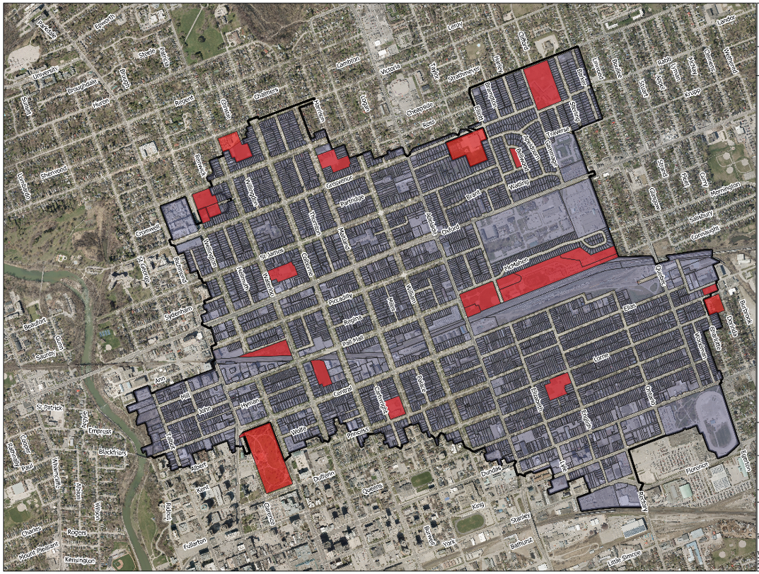
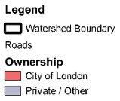
Opportunities for Stormwater Management Measures
Stormwater Management Master Plan measures will focus on using City owned property within the downtown core.
Where feasible, LID and stormwater measures will be integrated into municipal road right-of-ways or greenspace.
Storm sewer improvement alternatives will be considered if stormwater management alternatives are not feasible.
Notes:
It is anticipated that opportunities for implementation of stormwater management measures will focus on using City-owned property within the downtown core due to the built-out nature of the drainage area. Where feasible, low impact development and stormwater measures will be integrated into municipal road rights-of-way or greenspace. In some cases, it is anticipated that storm sewer conveyance capacity improvement alternatives will be considered if stormwater management alternatives are not feasible.

Slide 29
Next Steps
Notes:
For the final section of this presentation, I will provide a quick description of the next steps for this project.

Slide 30
Next Steps
Technical Analysis – Development of Servicing Alternatives, review of stormwater management concepts, infrastructure cost assessment, development of a climate change adaptation strategy.
Archaeological Review of Study Area (Desktop)
Natural Heritage Review of Study Area (Desktop)
Cultural Heritage Review of Study Area (Desktop)
Geotechnical Review and Characterization of Study Area (Desktop)
Notes:
Following completion of any outstanding modelling tasks, we will finalize the overall existing conditions flood risk assessment for Carling Creek and complete a sensitivity assessment of the existing system resiliency related to climate change and anticipated future developments. We will then develop mitigation alternatives to reduce flood risk and improve the level of storm sewer servicing in identified areas of flood risk. Following the development of the mitigation alternatives, we will host another Public Information Centre to present the alternatives. Feedback gathered at that meeting will be considered during our evaluation of the mitigation alternatives before preparing the implementation plan for storm water improvements.

Slide 31
Contact Information
If you would like to be included on the project mailing list and/or provide input, please complete the project flooding survey form available at
Carling Creek Master Plan | Get Involved London
and submit by email to:
nkrygsman@matrix-solutions.com
Input from Public Information Centre No. 1 will be received until
December 15, 2022
Thank you for participating!
Contact Information:
Monica McVicar, P.Eng.
Project Manager, Environmental Services – Stormwater Engineering
City of London
mmcvicar@london.ca
Phone: (519) 661-2489 x4589
Nicholas Krygsman, P.Eng.
Consultant Project Manager
Matrix Solutions Inc.
nkrygsman@matrix-solutions.com
Phone: 519.859.0911
Notes:
Thank you for attending this presentation. As we’ve mentioned, your feedback and input is an important part of the Master Plan process. Please complete and submit a flooding survey form. The flooding survey is available online in digital fillable or print friendly versions. You can submit via email to the addresses on the screen or print a copy and drop it off at City Hall. Please stay tuned for our second Public Information Centre in a couple of months.

Slide 32
Thank you!

