Slide 1

Kilally Infrastructure Project
getinvolved.london.ca/kilally-infrastructure-project

Slide 2
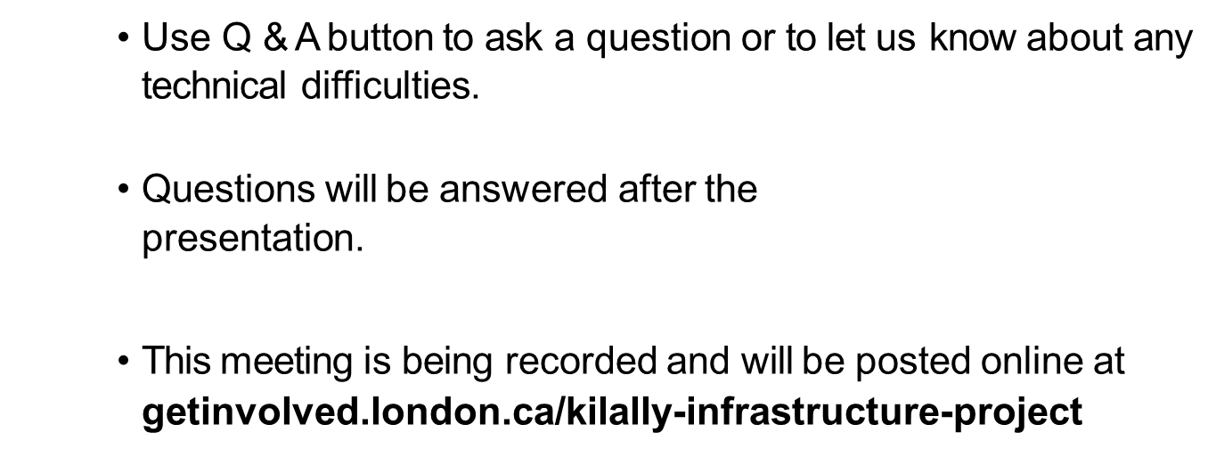



Welcome

Slide 3
Land Acknowledgement
The City of London is situated on the traditional lands of the Anishinaabek, Haudenosaunee, Lūnaapéewak and Attawandaron.
We honour and respect the history, languages and culture of the diverse Indigenous people who call this territory home.
The City of London is currently home to many First Nations, Metis and Inuit people today. As representatives of the people of the City of London, we are grateful to have the opportunity to work and live in this territory.
Notes:
We’d like to acknowledge that we are gathered today on the traditional lands of the Anishinaabek (AUh-nish-in-ah-bek),
Haudenosaunee (Ho-den-no-show-nee),
Lūnaapéewak (Len-ah-pay-wuk) and
Attawandaron (Add-a-won-da-run) peoples.
We honour and respect the history, languages and culture of the diverse Indigenous people who call this territory home.
We acknowledge all the treaties that are specific to this area: the Two Row Wampum Belt Treaty of the Haudenosaunee Confederacy/Silver Covenant Chain; the Beaver Hunting Grounds of the Haudenosaunee NANFAN Treaty of 1701; the McKee Treaty of 1790, the London Township Treaty of 1796, the Huron Tract Treaty of 1827, with the Anishinaabeg, and the Dish with One Spoon Covenant Wampum of the Anishnaabek and Haudenosaunnee.
The three Indigenous Nations that are neighbours to London are the Chippewas of the Thames First Nation; Oneida Nation of the Thames; and the Munsee-Delaware Nation who all continue to live as sovereign Nations with individual and unique languages, cultures, and customs…. I’ll now pass things over to our first presenter.

Slide 4
Project Design Team
Peter Kavcic
Manager, Subdivisions and Development Inspections
City of London
Trevor Hitchon
Senior Technologist
City of London
Simon Jeater
Project Manager
Stantec Consulting

Slide 5
Presentation Overview
Project design details for Kilally Infrastructure Project
Construction phasing
Road improvements – Cross sections
Road improvements – Intersections
Tree impacts
Traffic impacts
Next steps
Q&A Session

Slide 6
Project Overview
Kilally Road from Webster Street to Sandford Street
  Includes curb & gutter, sidewalks, bike lanes, and hydro pole relocation
2. Kilally Road from Sandford Street to Clarke Road
  Includes ditches, bike lanes along the shoulder
  no sidewalks or curbs
Sandford Street from Kilally Road to 200m south
  Includes new turning lane and asphalt resurfacing of Sandford Street southerly to Toronado Place. (total approximately 480 metres)
Underground Infrastructure along Kilally Includes
  New watermain, storm and sanitary sewers
5. New Storm Outlet along Clarke Road to the Thames River.

Slide 7
Construction Timeline

Slide 8

Construction Phasing
Phase 1
April to December 2025
Installation of storm sewers, sanitary sewers and watermain along Kilally Road
Road widening, including bike lanes
New storm sewer outlet and headwall to the Thames River
Utility relocation completed between Webster Street and Sandford Street concurrently with Phase 1 works

Slide 9
Construction Phasing
Phase 2
April to December 2026
Installation of storm sewers, sanitary sewers and watermain along Kilally Road
Road widening, including dedicated bike path and concrete sidewalk

Slide 10
Road Improvements - Sections
Kilally Road from Sandford Street to Clarke Road
Proposed
Future Ultimate Right of Way - 36m
Improved asphalt road
Improved ditch drainage
Bike lanes with buffer markings
Existing

Slide 11
Road Improvements - Sections
Kilally Road from Webster Street to Sandford Street
Proposed
Ultimate Right of Way - 36m
Improved asphalt road
Concrete curbs
Concrete sidewalks
Dedicated bike lanes with grass buffer
Existing

Slide 12
Road Improvements - Intersections
Kilally Road and Sandford Street

Slide 13
Road Improvements - Intersections
Kilally Road and Clarke Road

Slide 14
Tree Impacts
Total tree removals, all phases: 222 trees
Removals from Clarke Rd: 53 trees
Removals from Kilally Rd: 169 trees
Species to be removed include:
19% Norway Spruce
18% Black Walnut
10% Sugar Maple
7% Ash
6% Hackberry
40% 18 other species
Removals include 13 dead trees
Trees are generally being removed due to the following:
Constructability (grading, hydro, gas, etc.)
Road/Public safety
Trees in poor health/dead

Slide 15
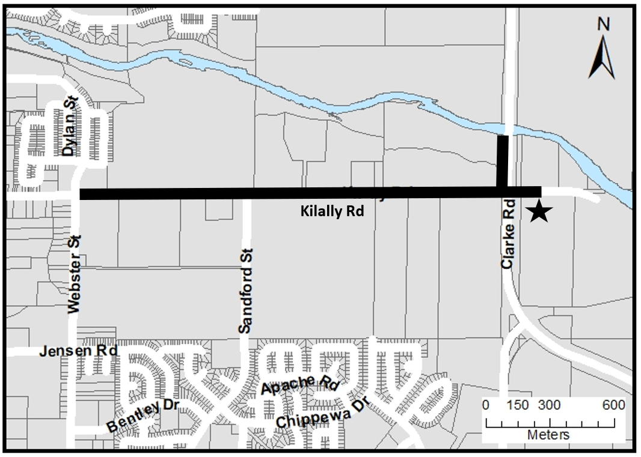
Anticipated Traffic Impacts
A complete road closure will be in place for the duration of each phase of construction.
The contractor and City of London will work with the local residents to maintain access to their individual properties.
Access may be limited from time to time. Advance notice will be provided to each resident.
The contractor will be in contact with the residents and a contact number will be provide to the residents to address concerns as they arise.

Slide 16

Mitigating Construction Impacts
The City will continue to emphasize communication and coordination to minimize potential impacts to residents and businesses during construction.
Resources will be provided to businesses and residents to help navigate construction

Slide 17
Next steps
Detailed design is being finalized
A notice will be sent to impacted residents, businesses and property owners ahead of the construction.
Construction is anticipated to begin early in 2025 and is projected to take three years to complete (2027).

Slide 18

How to stay informed
In-person drop-in session on Wednesday, December 4 from 6 to 7 p.m. at North London Community Centre (1345 Cheapside St).
Sign up for email notifications at: getinvolved.london.ca/kilally-infrastructure-project
Contact the project team at thitchon@london.ca or 519-661-2489

Slide 19
Q&A

